Slide 1
OIL PRICE PREDICTION

Slide 2
Introduction
Crude oil is a liquid found beneath the Earth's surface. It's made up of a mix of hydrocarbons formed by subjecting organic plant and animal material to millions of years of intense heat and pressure. It forms the basis for many petroleum products, including plastic, gas, and lubricating oils.
Crude oil prices typically fluctuate based on seasonal demand and supply and world events. While economic recovery from the pandemic is well underway, oil prices continue to be affected by global uncertainties and the oil price forecast will reflect this.

Slide 3
TEAM MEMBERS
1. Mr. Sangamesh Yadam
2. Mr. Patibandla Mahendra
3.Mr.C Vinod Kumar Reddy
4.Ms. Nikita Badrinarayan Choudhary
5.Ms. Sthanikam Bhavana
6.Ms. Ashwini
7.Ms. Bhoomika P M

Slide 4
STEPS INVOLVED:
1.Loading the dataset
2.Understanding the data
3.EDA
4.Visualisations
5.Preprocessing
6.Checking for Stationarity
7.Converting data into Stationarity
8.Model Building
9.Model Evaluation
10.Forecasting for future data

Slide 5
EDA
1.Loaded the data set and stored in a variable
2.Performed some operations to get info about dataset
3. Operations involved:
data.info()
data.isnull().sum()
data.describe()
4.imported pandas and seaborn libraries for visualisations
5.plottoed several graphs to get deep insights about dataset

Slide 6
Data Set
The dataset has been extracted from below website,
https://www.kaggle.com/code/bilavath/oil-price-prediction
The data set contains details such as Date, Close price, Volume, Open price, High and Low values. The data has 10 years information. The task is to predict the future oil price using present dataset.

Slide 7
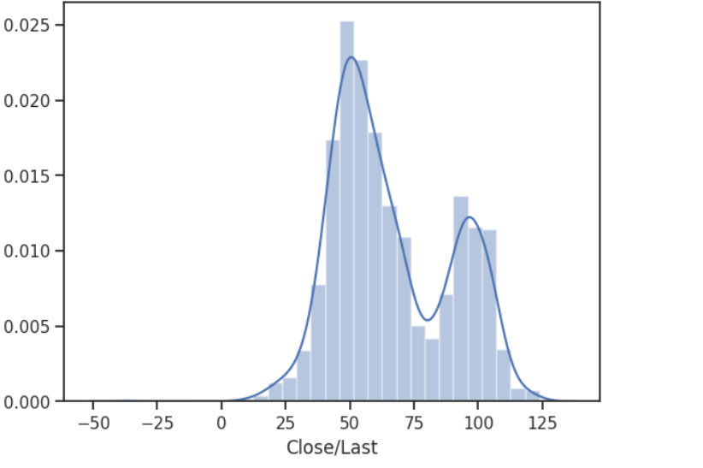
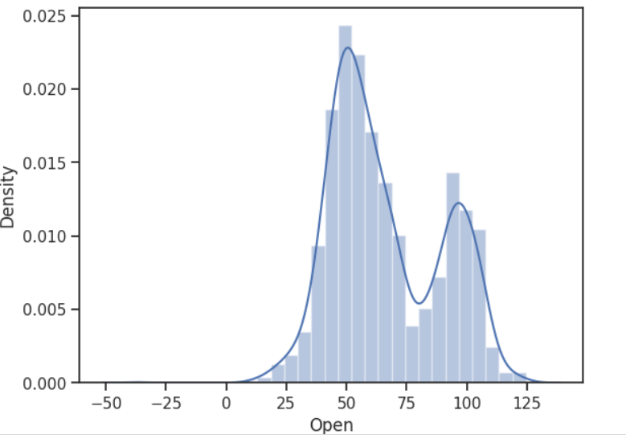
DIST PLOTS

Slide 8
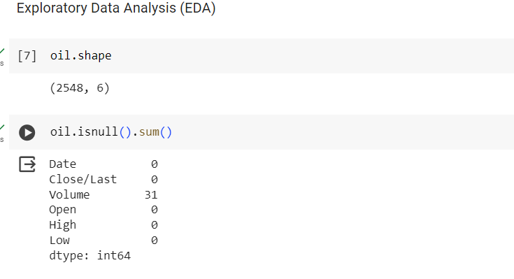
EDA
After importing the data it is checked whether any null values are present and in volume column some are present

Slide 9
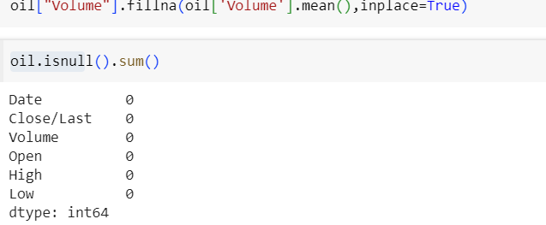
Removing Null Values
Null vales are replaced with mean succsefully

Slide 10
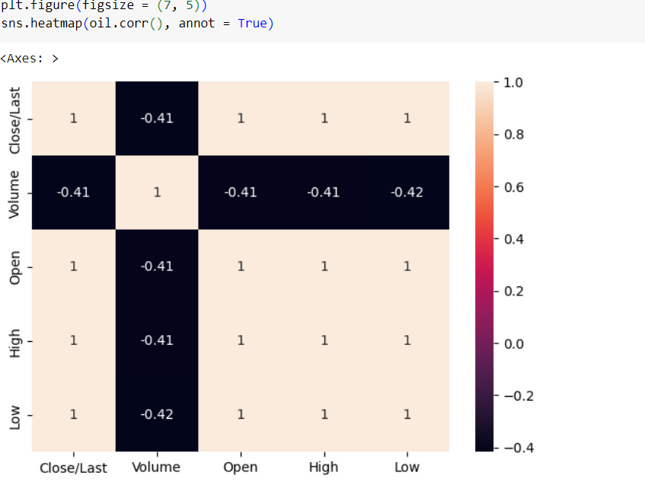
Correlation plot
Correlation is measured on a scale of -1 to 1. -1 means complete negative correlation and 1 means complete positive correlation. 0 means no correlation at all.

Slide 11
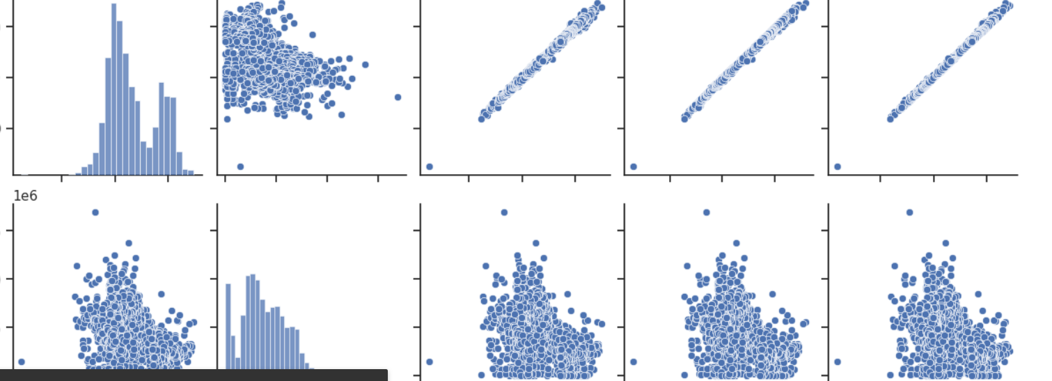
Pair plot before removal of outliers
We can see some outliers present in the data

Slide 12
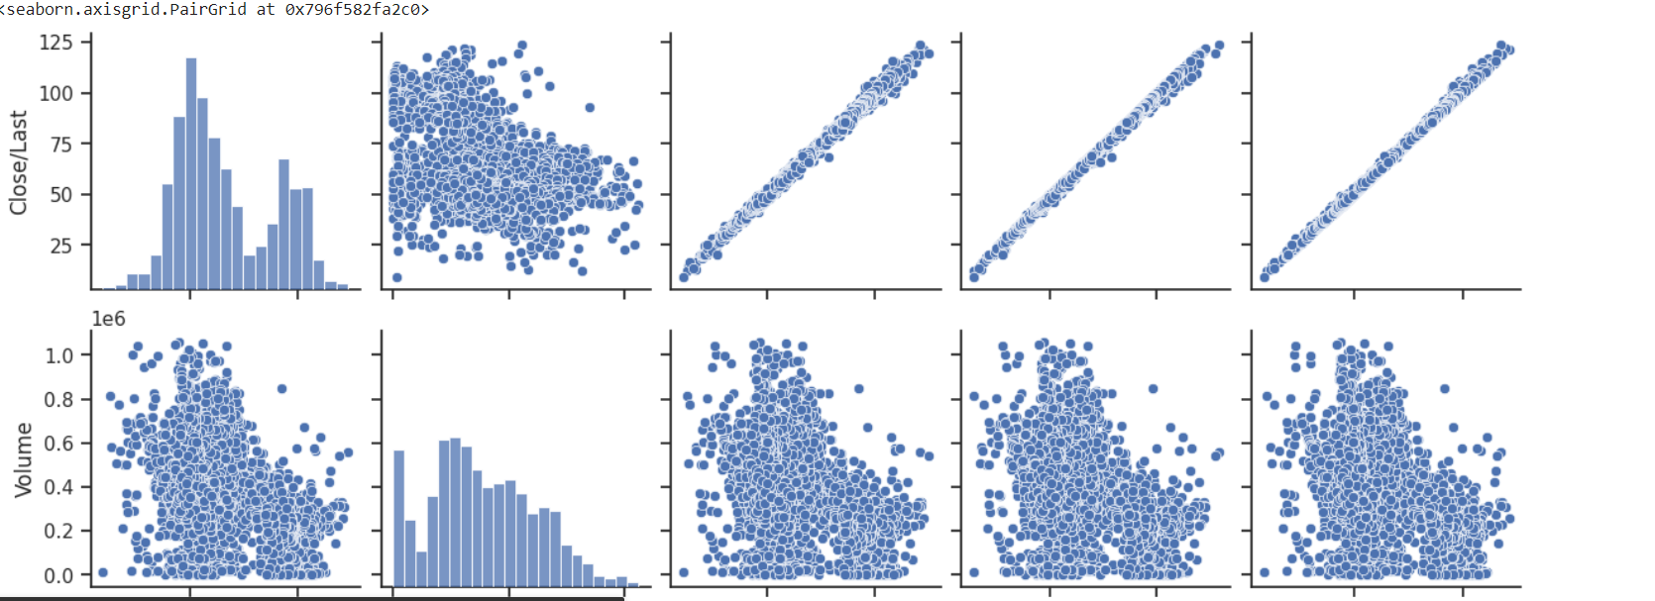
Pair plot after removal of outliers

Slide 13
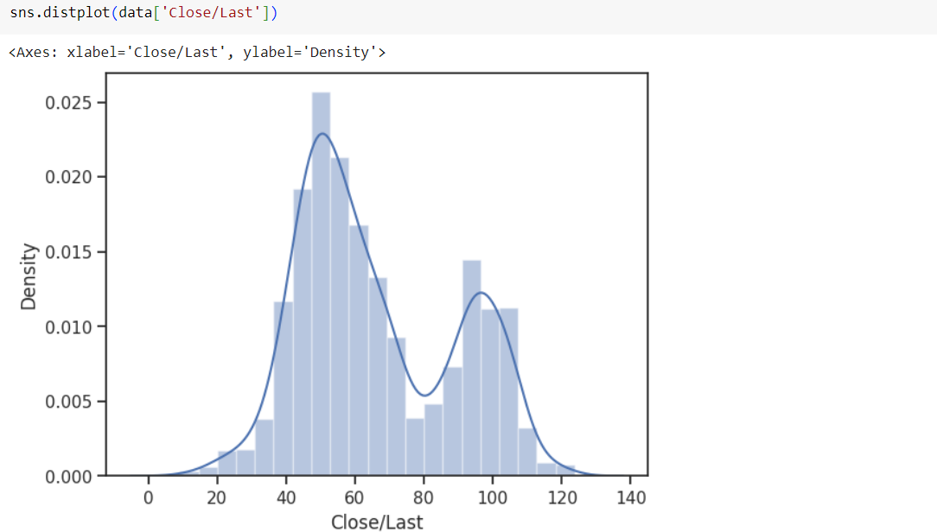
Dist plot
With the help of distplot we are able to know the distribution of the data

Slide 14
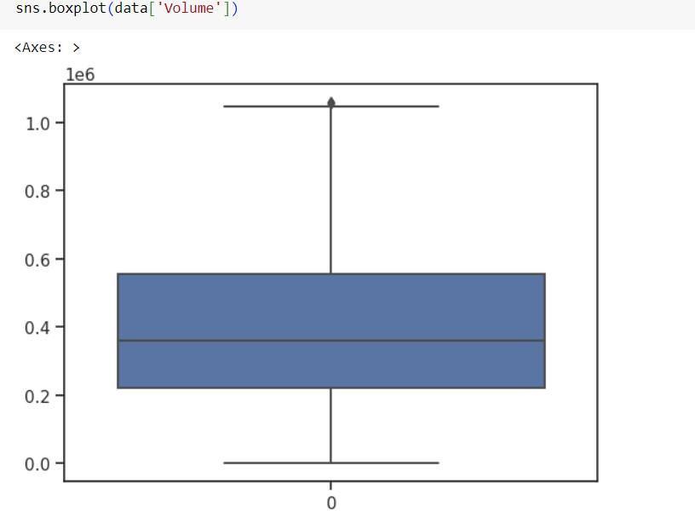
Box Plot
With the help of boxplot we can see the outlier present in the data and in the boxplot of volume there are no outliers present

Slide 15
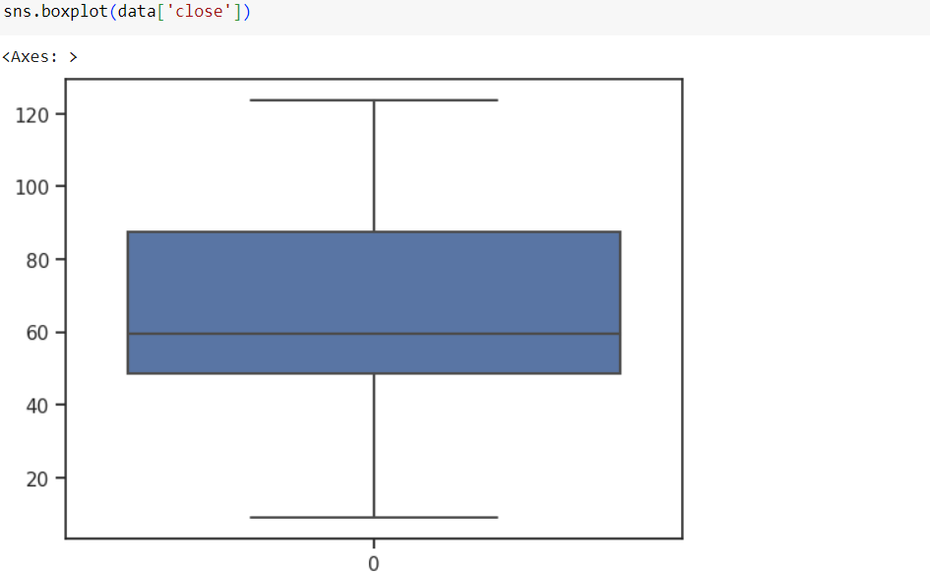
Box plot
With the help of boxplot we can see the outlier present in the data and in the boxplot of close there are no outliers present

Slide 16

Box plot
With the help of boxplot we can see the outlier present in the data and in the boxplot of volume there are no outliers present

Slide 17
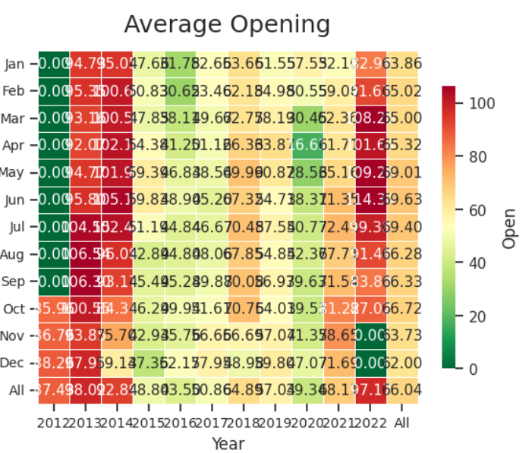
Generating the average open monthly price

Slide 18
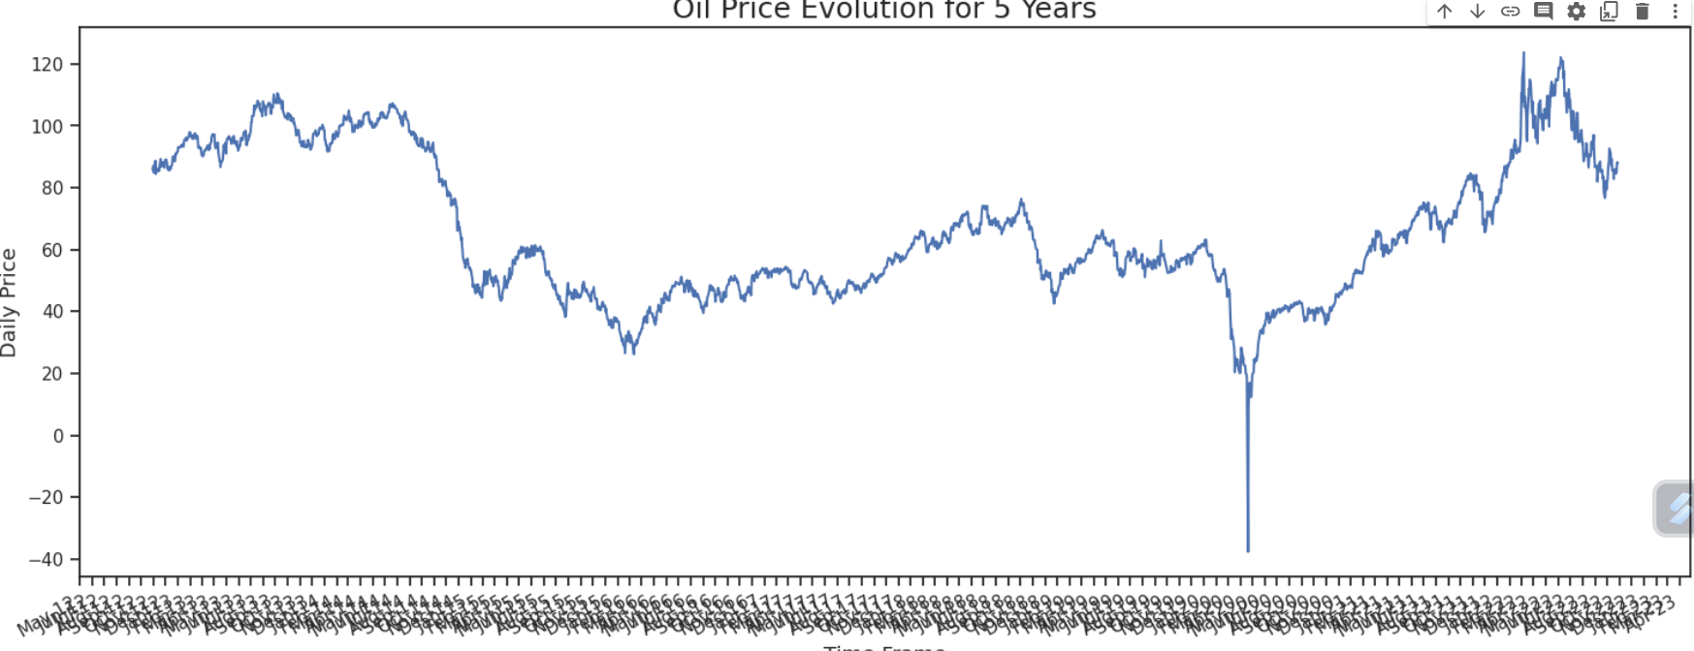
Time Series plot of price vs close

Slide 19
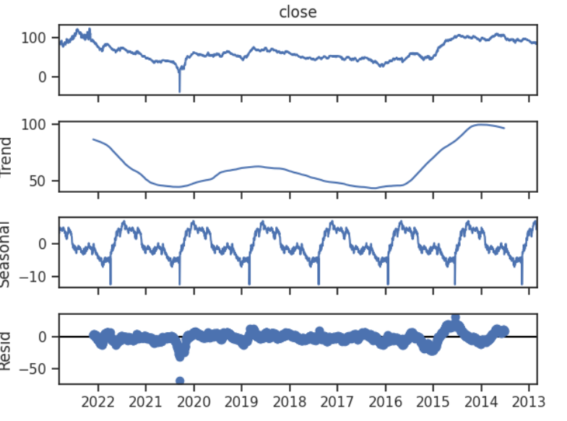
Plotting Trend and Seasonality in the data
From the decomposition plot we are not able to predict the Stationarity so we need to dicky-fuller-test

Slide 20
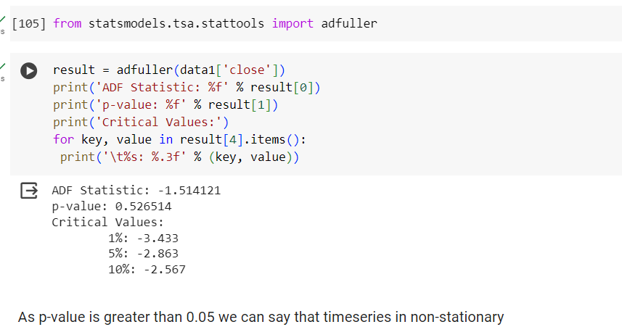
Dicky-Fuller-Test
As pvalue=0.5 which is greater than 0.5 we can say that series is non-stationary

Slide 21
TRANSFORMATIONS
1.STANDARDSCALER
2.MINMAXSCALER
3.POWER TRANSFORM
4.DIFFERENCE TRANSFORM
These are the transforms that can be applied to time series analysis

Slide 22
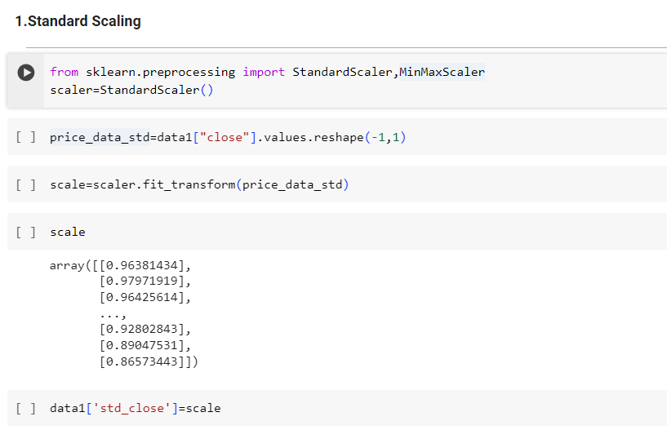
1.STANDARDSCALER
Standardisation is applied to the datasset

Slide 23
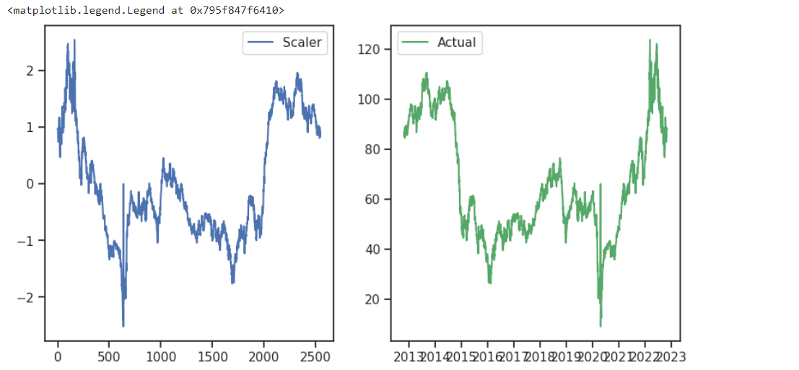
Plot of Standarized data vs actual data

Slide 24
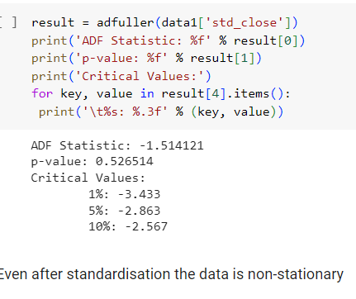
Dicky Fuller Test for Standardized data

Slide 25
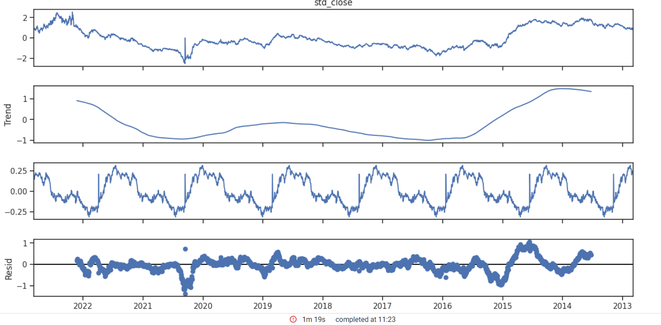
Seasonal Decomposition of Stanadarized data

Slide 26
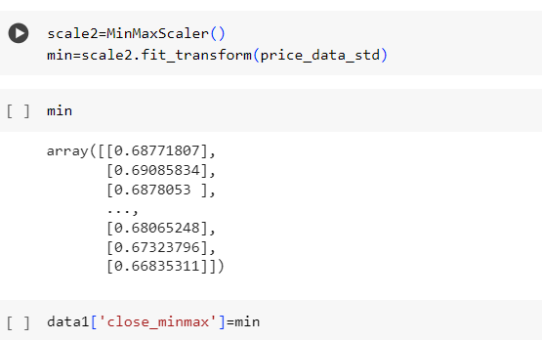
2.MinMaxScaler

Slide 27
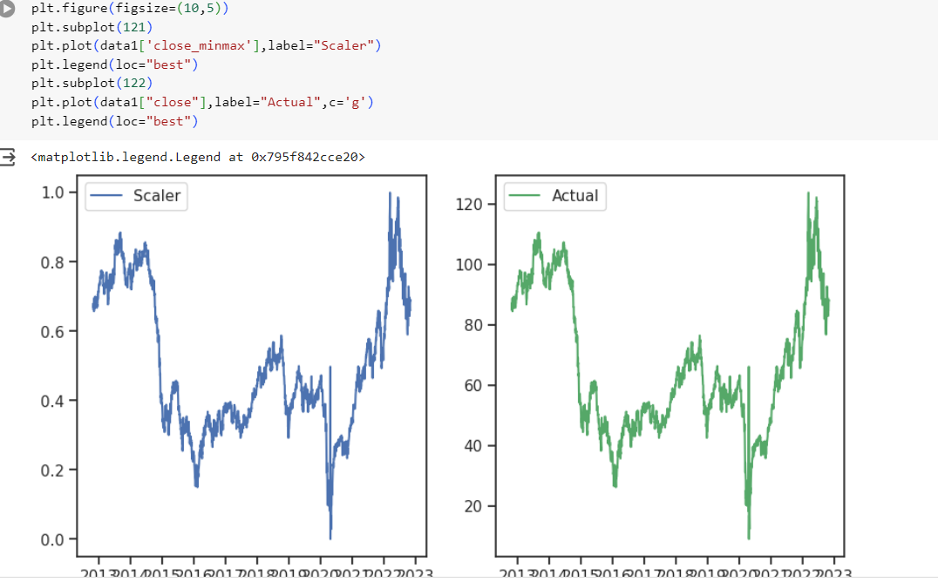
Plot of MinMaxData vs Actual Data

Slide 28
Dicky Fuller Test for MinMax data

Slide 29
Seasonal Decomposition of MinMax data

Slide 30
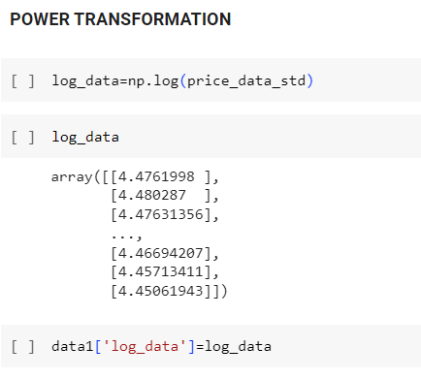
3.POWER TRANSFORMATION

Slide 31
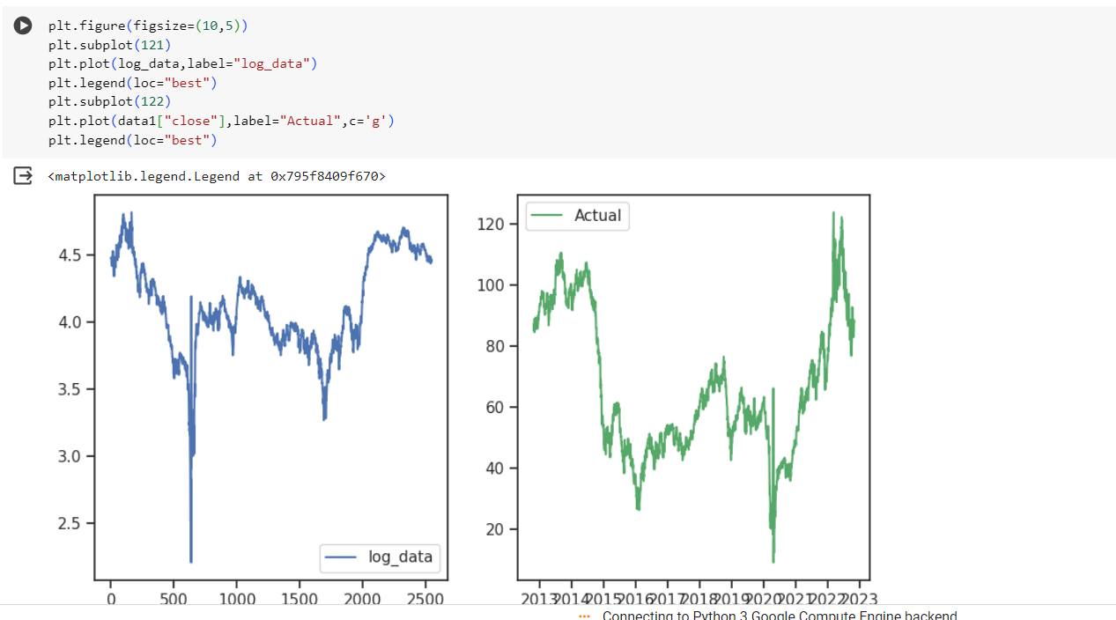
Plot of Power Transformed Data vs Actual data

Slide 32
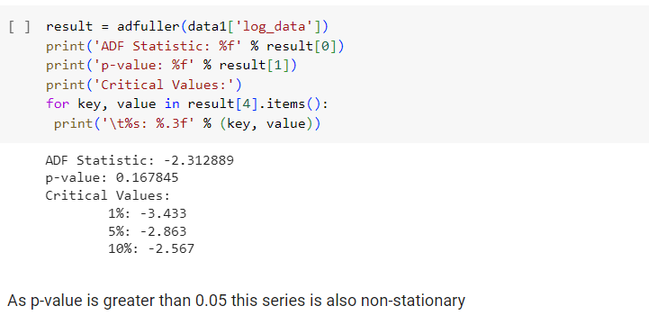
Dicky Fuller Test for PowerTransformed data

Slide 33
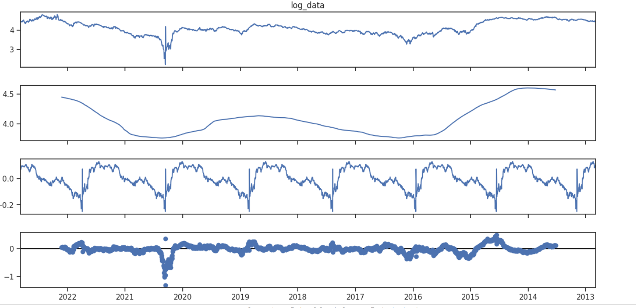
Seasonal Decomposition of Power Transformed Data

Slide 34
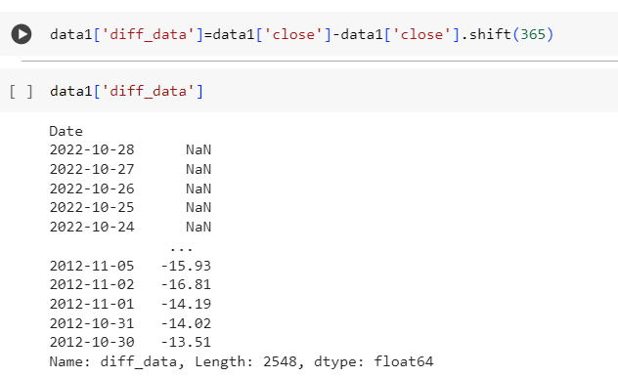
4. Difference Transform

Slide 35
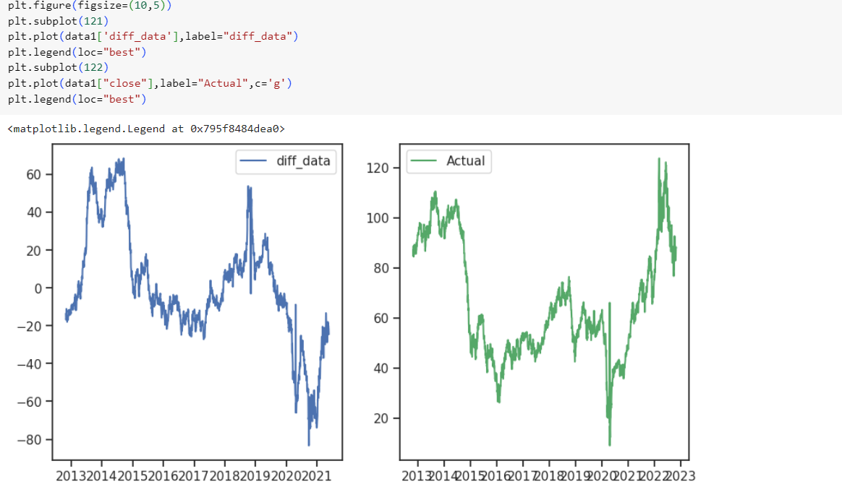
Plot of Differenced Data vs Actual data

Slide 36
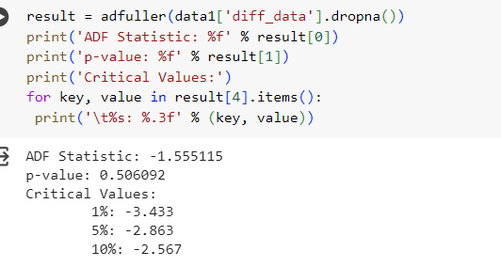
Dicky Fuller Test for Differenced data

Slide 37
MODEL BUILDING
1.LSTM
2.ARIMA
3.SARIMAX
4.EXPONENTIAL SMOOTHENING

Slide 38
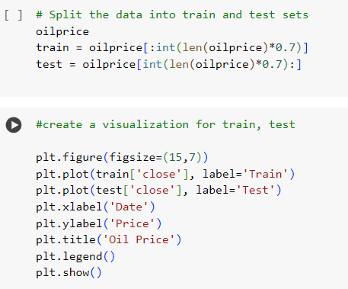
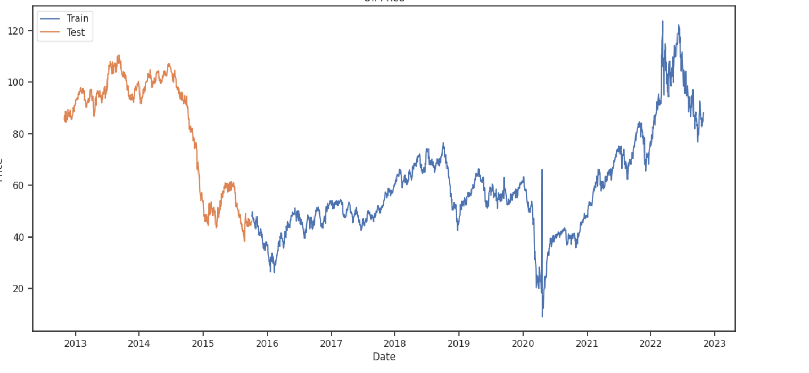
TEST AND TRAIN DATA

Slide 39
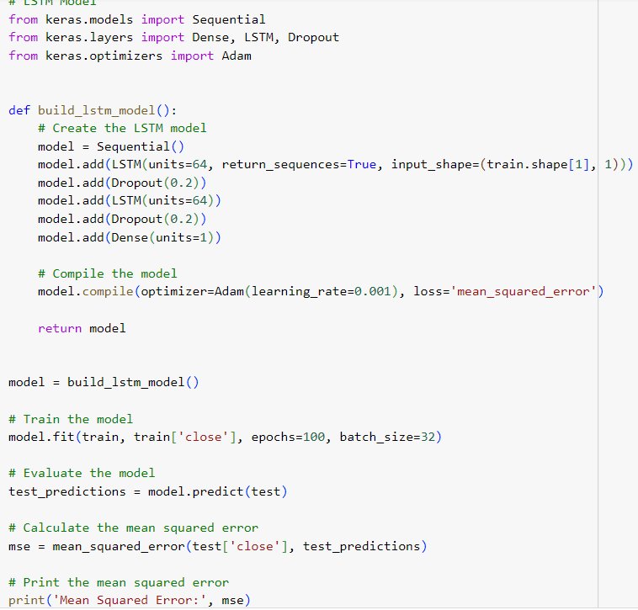
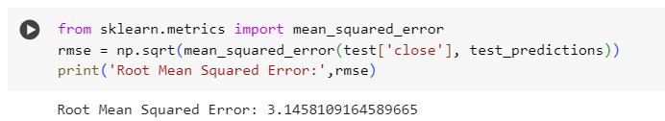
1.LSTM

Slide 40
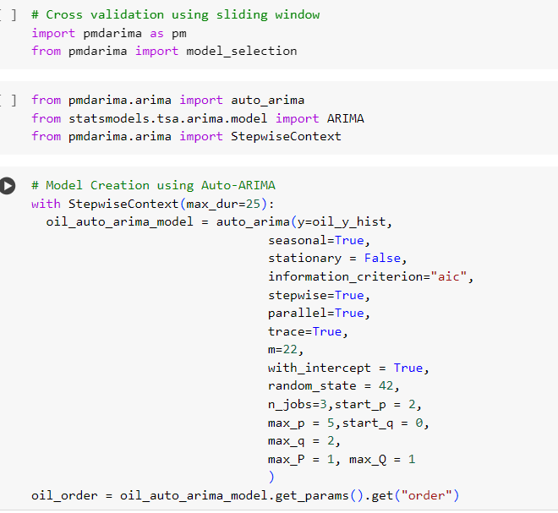
2.ARIMA

Slide 41
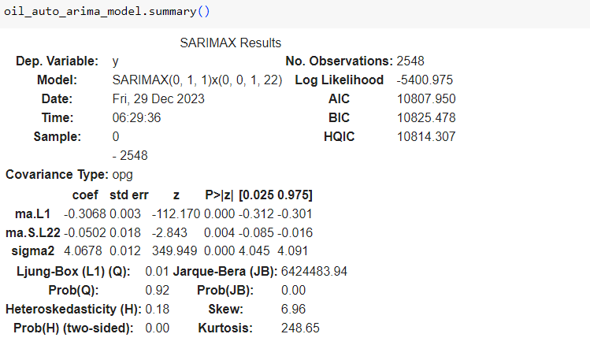

Slide 42
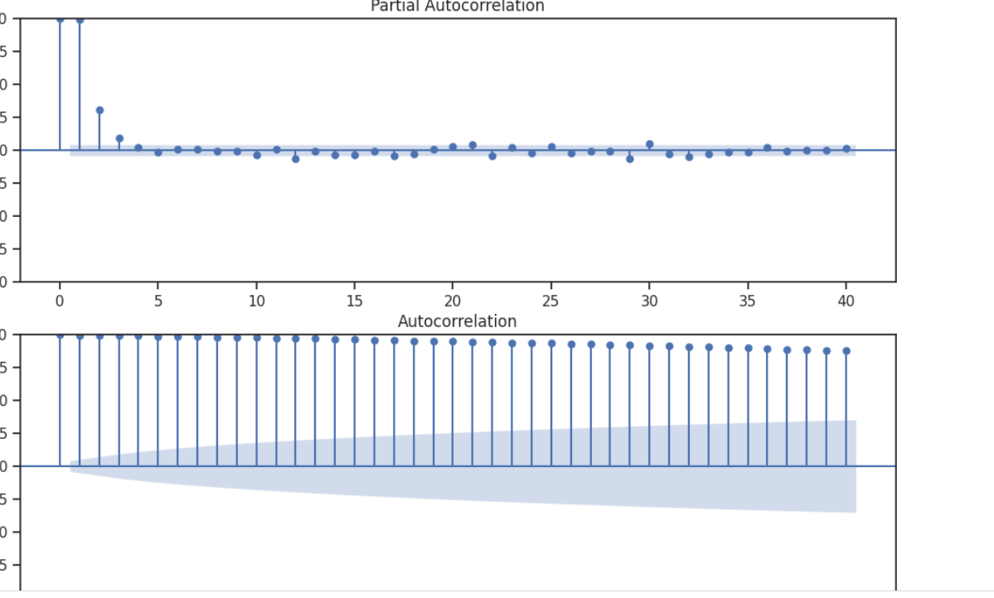
PACF AND ACF PLOTS

Slide 43
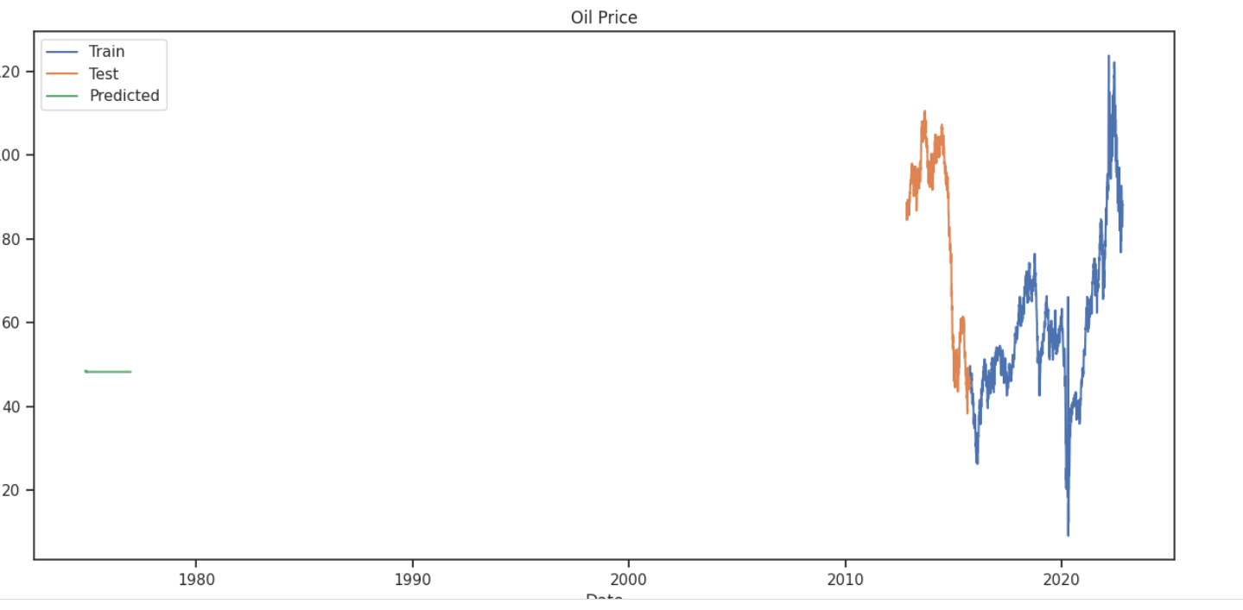
ARIMA FORECAST

Slide 44
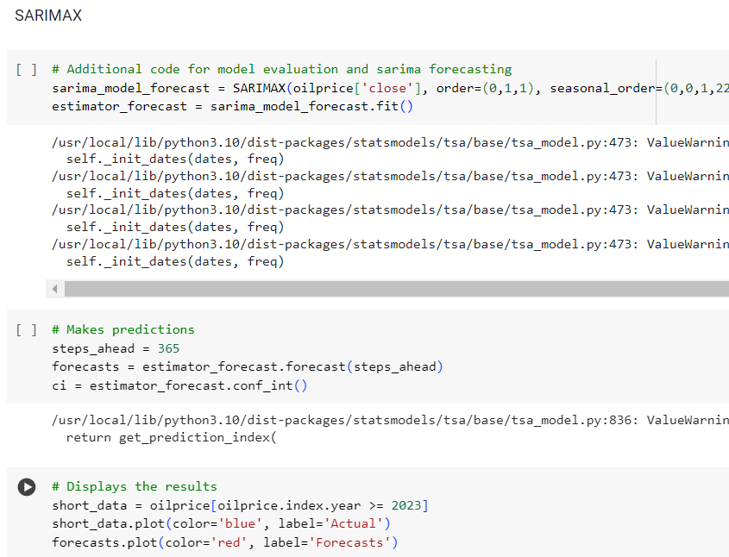
SARIMAX

Slide 45
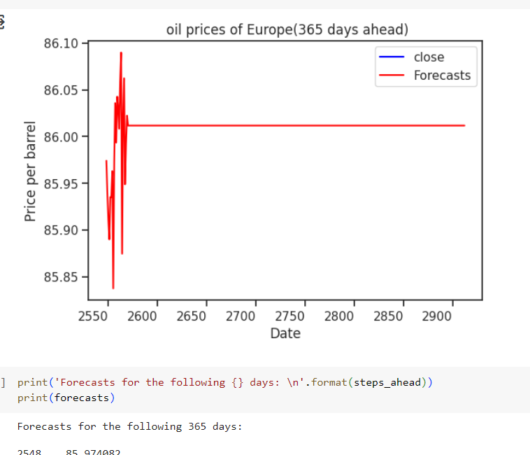

Slide 46
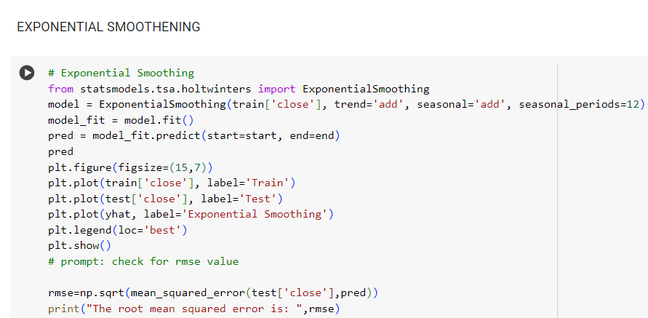
EXPONENTIAL SMOOTHENING

Slide 47
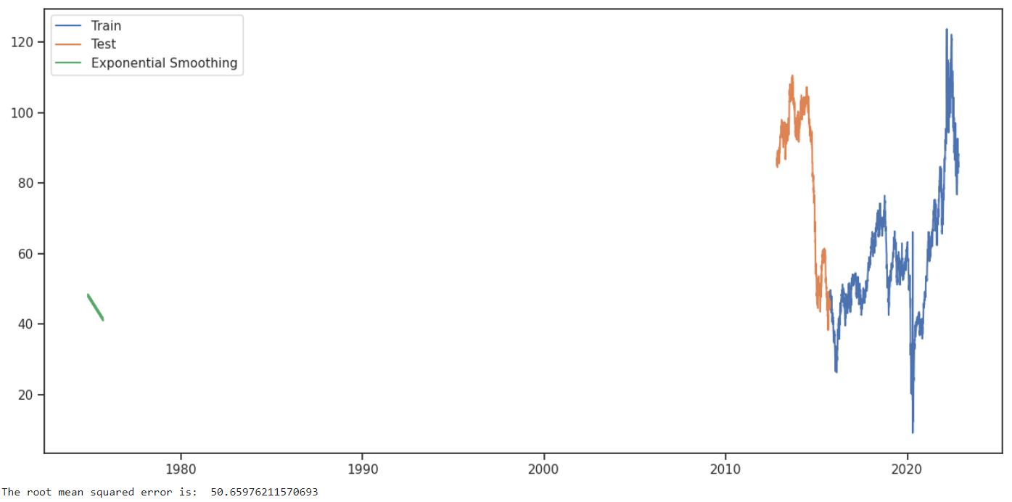

Slide 48
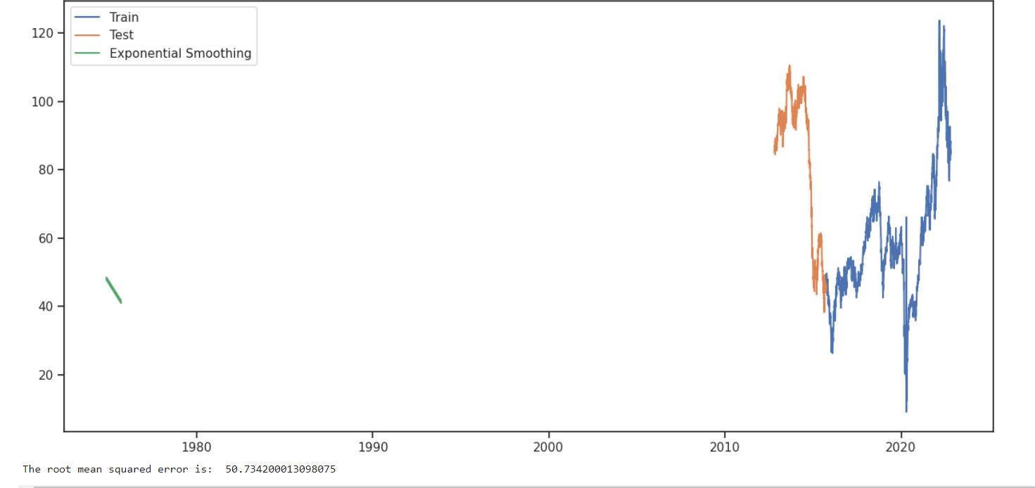

Slide 49
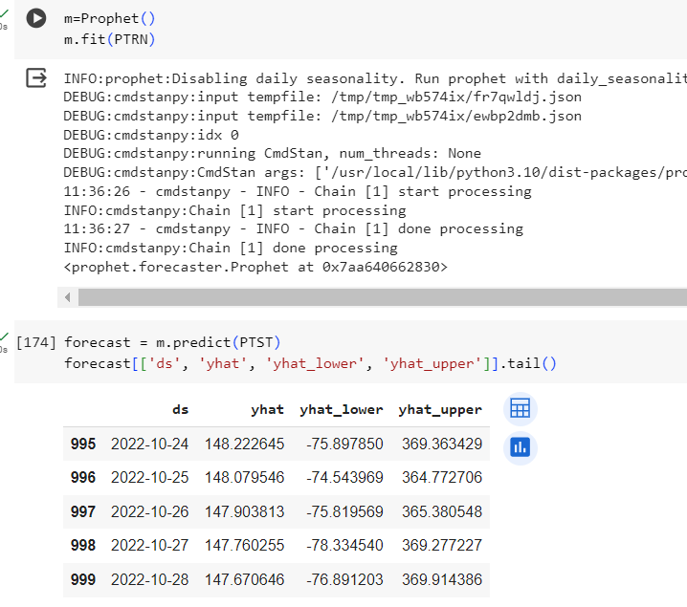
FBPROPHET MODEL

Slide 50
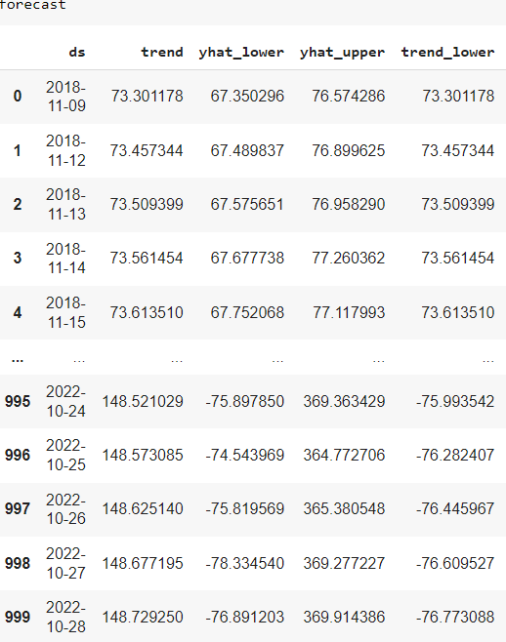
Forecasted data using FBProphet Model

Slide 51
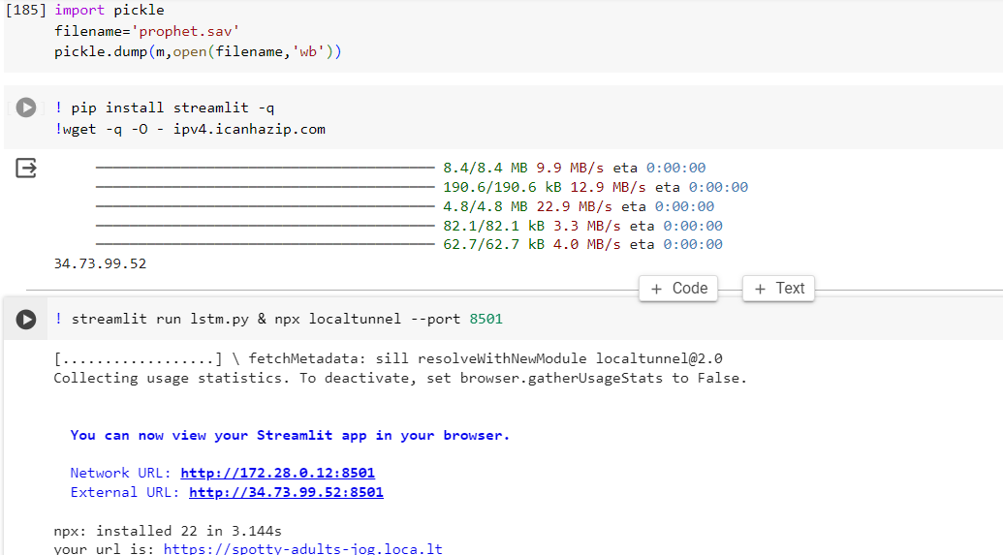
MODEL DEPLOYMENT USING STREAMLIT
Streamlit Code using Google Colab

Slide 52
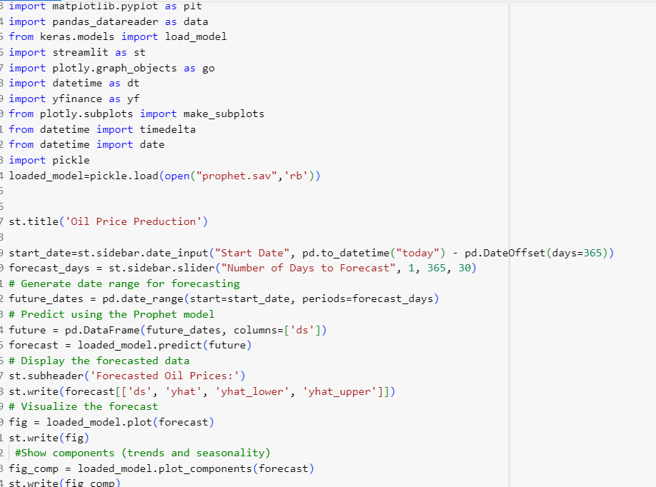
PROPHET.PY
Code to deploy the model

Slide 53
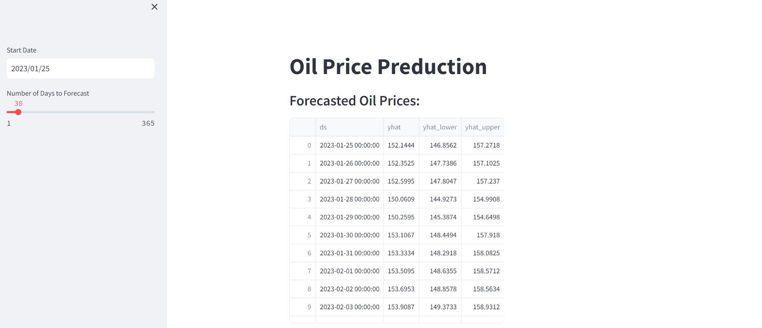
MODEL EXECUTION USING WEBAPP
The data is forecasted from 5/01/2023 to 6/01/2023

Slide 54
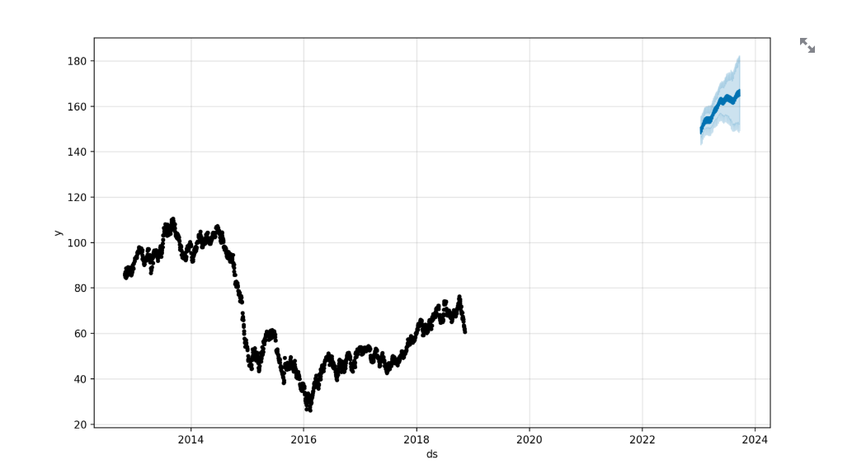
Plot of forecasted data

Slide 55
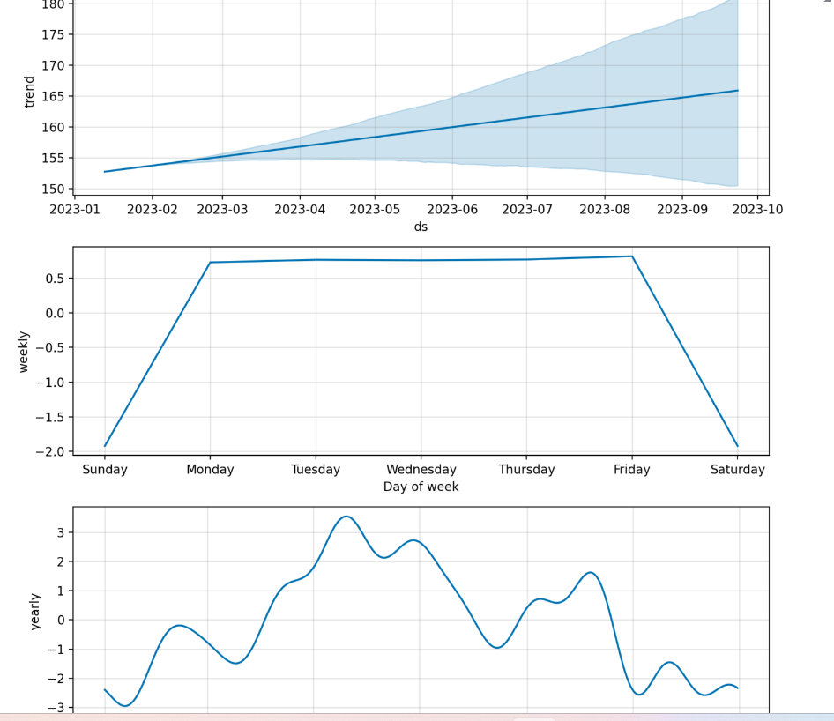
Components plot of Forecasted data

Slide 56
Challenges and the solutions:
There are several challenges that we under went while building the project:
1. Generation of Data from Multiple Sources
Data is obtained by organizations in a broad variety of forms from the many programs, software, and tools that they use. Managing voluminous amounts of data is a significant obstacle for data scientists. This method calls for the manual entering of data and compilation, both of which are time-consuming and have the potential to result in unnecessary repeats or erroneous choices.
2. Data cleansing
Data cleansing or removing unwanted data from a data set is one of the pressing challenges of data science. It is observed that companies lose almost 25% of their revenue as cleaning bad data is costly. Working on data sets consisting of many inconsistencies and unwanted information can create havoc in a data scientist’s life!

Slide 57
3. Building Different Models
For predicting time series data there are number of models to forecast the data and selecting the best model which fits for our data is complicated task.
4. Evaluating the models performance
For each model we need to forecast and evaluate the performance of each model which is a difficult task.
5. Converting the data into stationary series
Initial data was non-stationary which is not helpful to build the models but later on converted into stationary series which is able to forecast the data accurately.

Slide 58
THANK YOU

